Slide 1
Module 4
CISCO SYSTEM

Slide 2
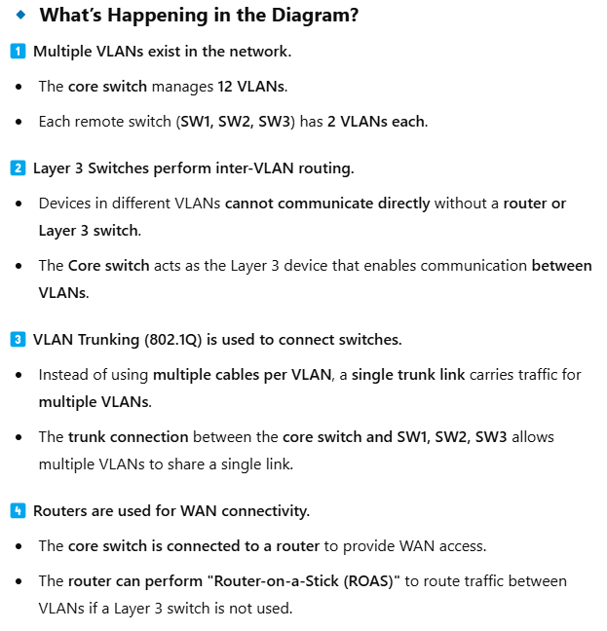
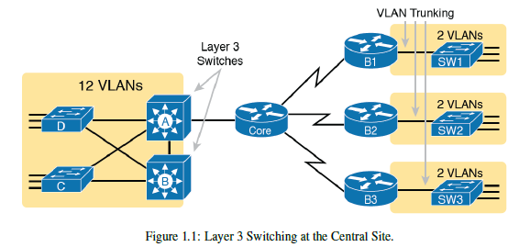
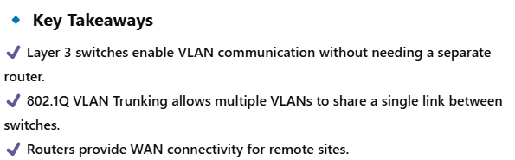
Layer 3 Switching at the Central Site 🚀

Slide 3
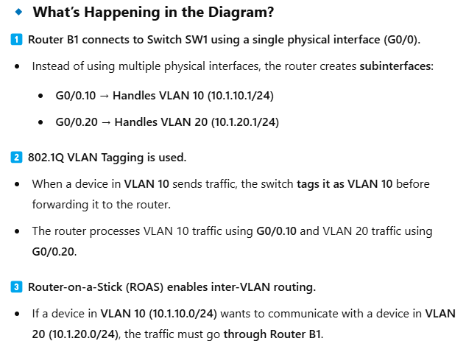
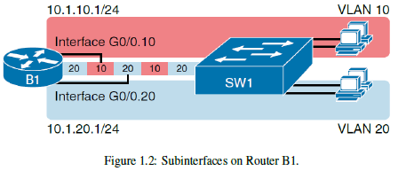
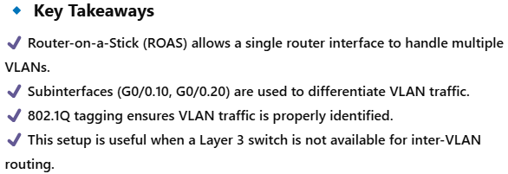
Subinterfaces on Router B1 🚀
This figure explains how Router-on-a-Stick (ROAS) is used to route between VLANs using a single physical connection.

Slide 4
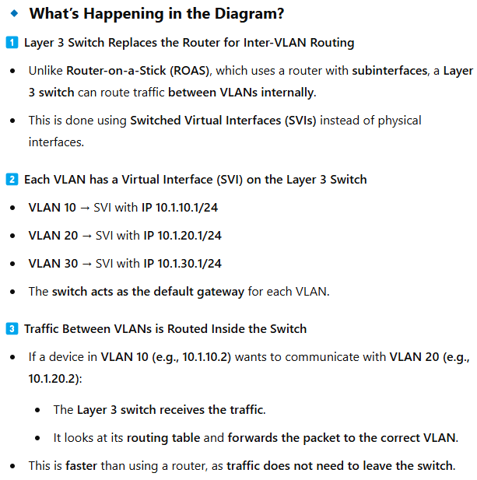
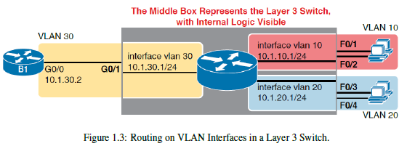
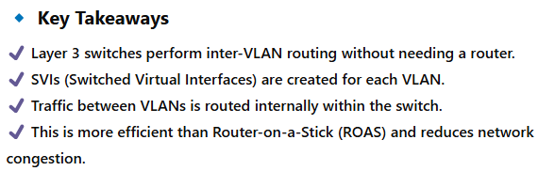
Routing on VLAN Interfaces in a Layer 3 Switch 🚀
This figure explains how a Layer 3 switch is used for inter-VLAN routing without needing a separate router.

Slide 5

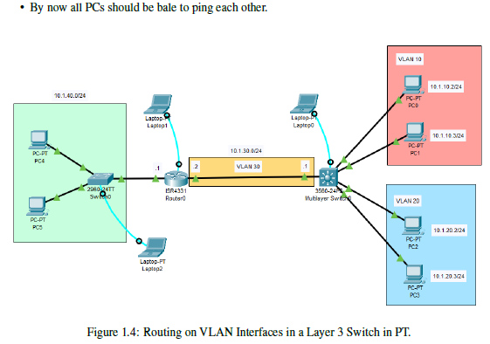

Slide 6
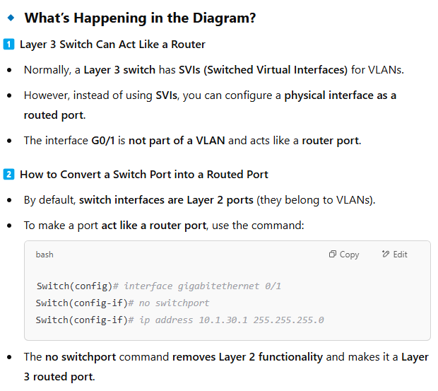
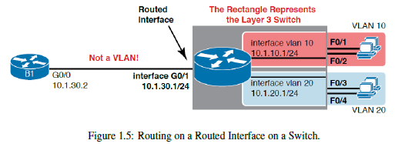
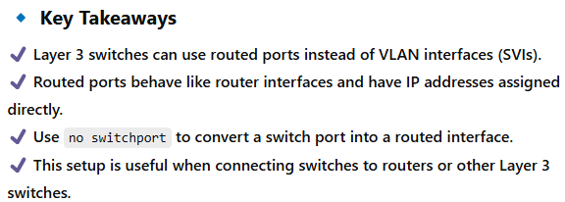
Routing on a Routed Interface on a Switch 🚀

Slide 7
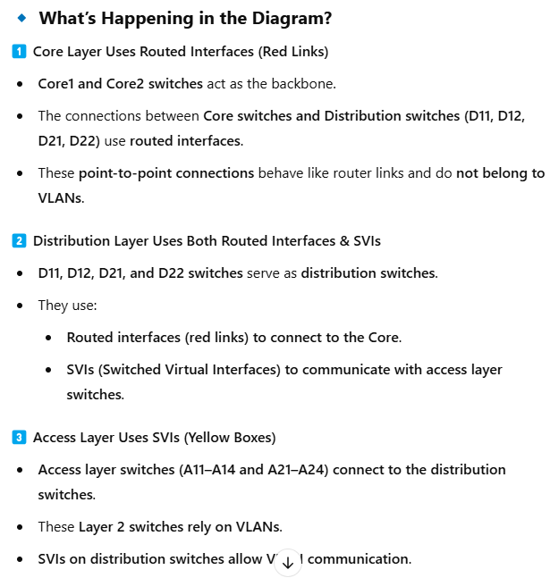
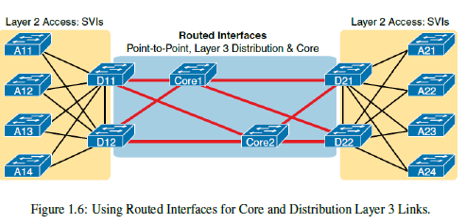
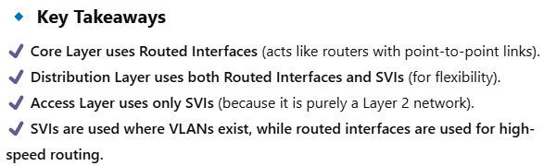
Using Routed Interfaces for Core and Distribution Layer 3 Links 🚀
This figure explains how SVIs (Switched Virtual Interfaces) and Routed Interfaces are used in a typical core/distribution/access network design.

Slide 8
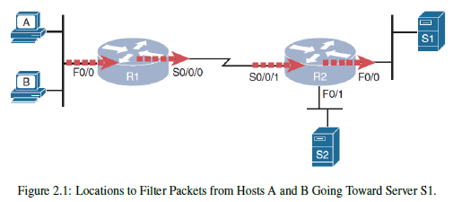
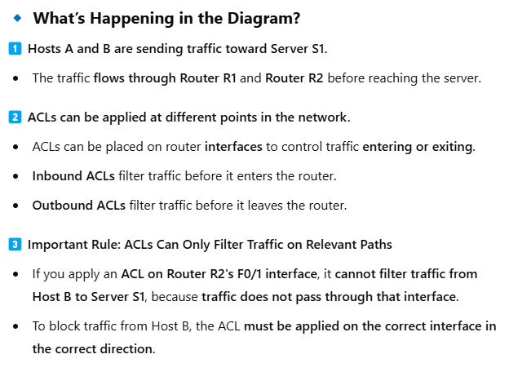
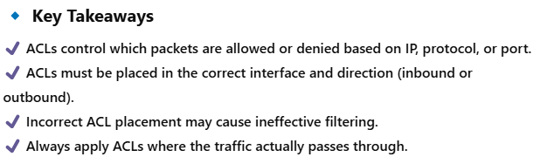
Locations to Filter Packets Using ACLs 🚀
This figure explains how Access Control Lists (ACLs) are used to control traffic flow on a network.

Slide 9
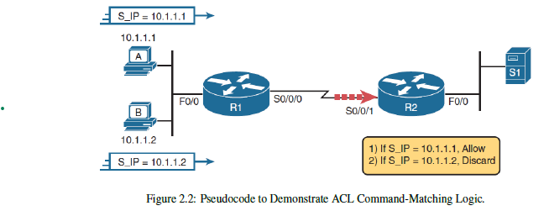
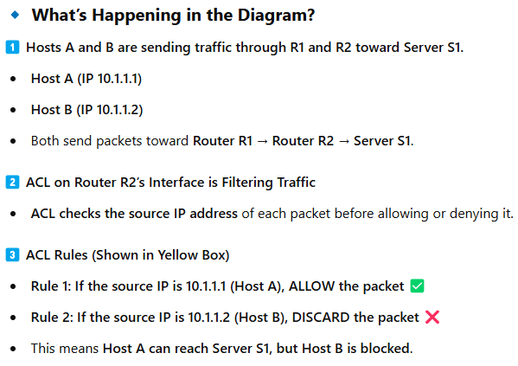
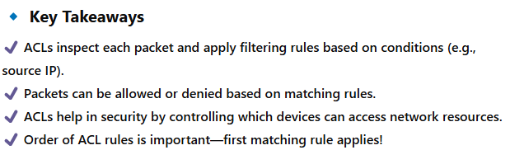
ACL Command-Matching Logic 🚀
This figure explains how Access Control Lists (ACLs) filter network traffic based on specific rules.

Slide 10
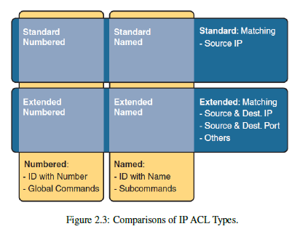
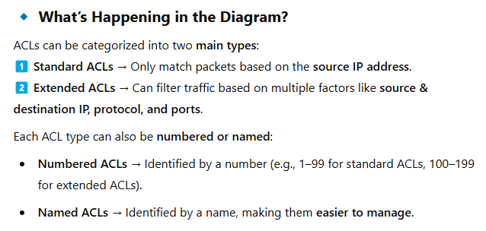
Comparisons of IP ACL Types 🚀
This figure explains the different types of Access Control Lists (ACLs) used in Cisco IOS.

Slide 11
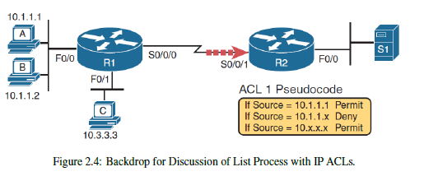
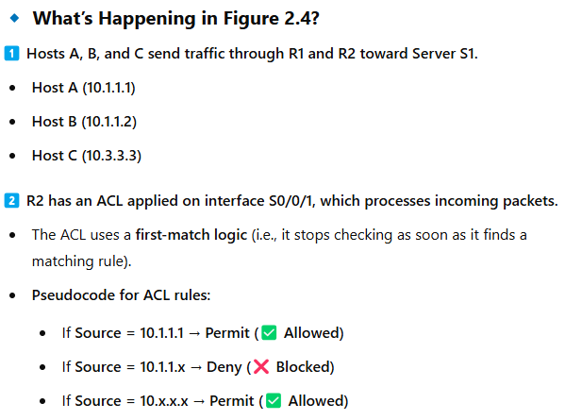
ACL Processing in Action 🚀
These figures illustrate how Access Control Lists (ACLs) work in a Cisco router to permit or deny packets based on IP addresses.

Slide 12
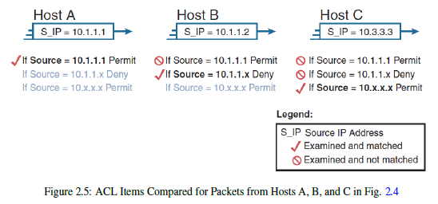
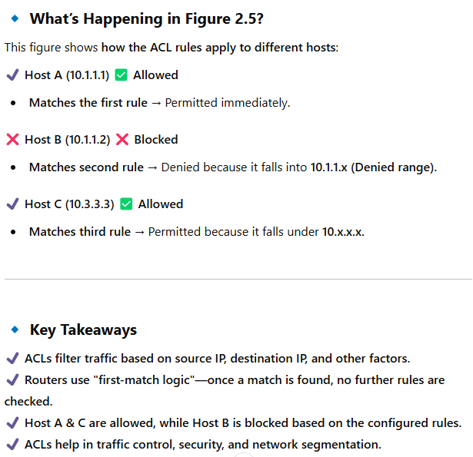

Slide 13
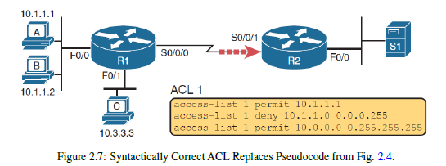
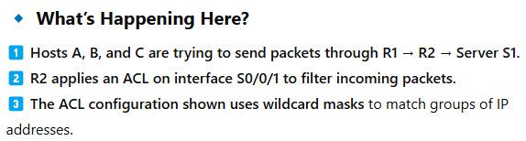
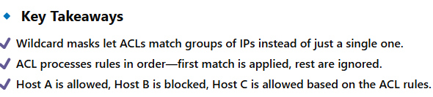
ACL with Wildcard Masks 🚀
This figure shows how a correctly written Cisco ACL replaces the pseudocode ACL from Figure 2.4. It introduces wildcard masks (WC masks) to control which IP addresses are matched.

Slide 14
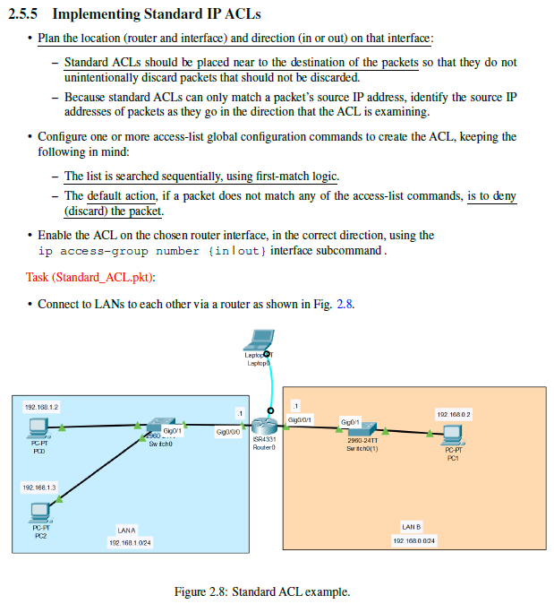
Prevent access any access from PC0 to LAN B, but allow PC2 access to LAN B.

Slide 15
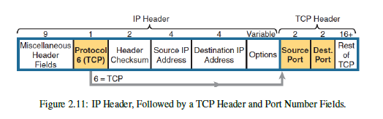
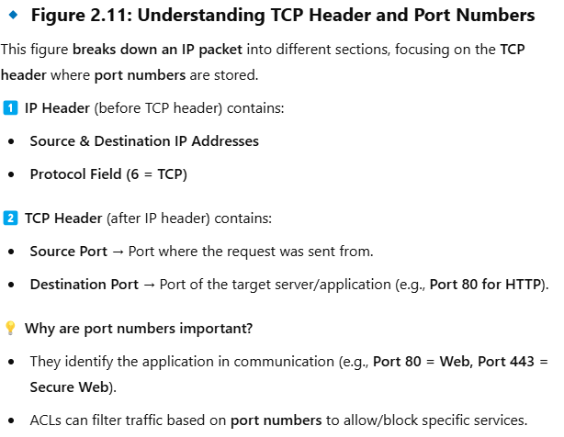
TCP & UDP Port Matching in Extended ACLs 🚀

Slide 16
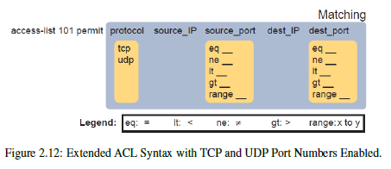
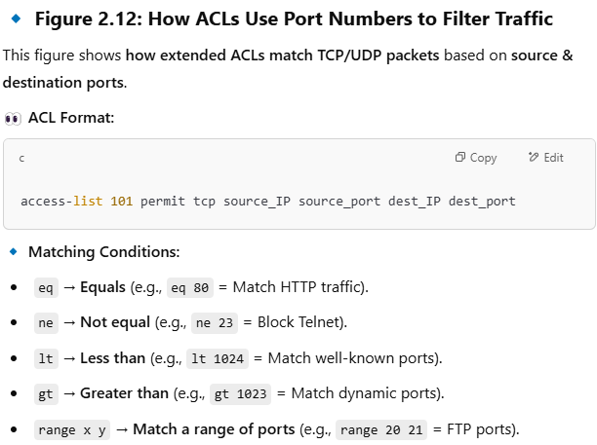
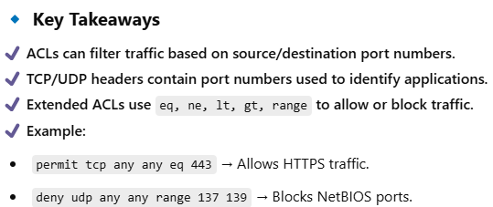

Slide 17

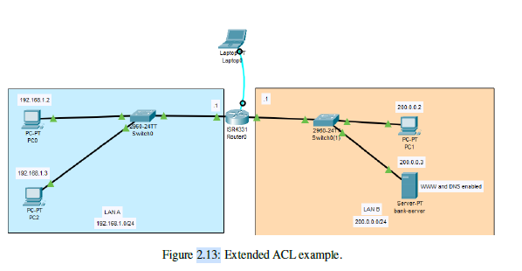
Initially both PC0 and PC2 can reach the web server http://bankserver. Write extended ACLs to
prevent access to the web server from PC0 but still allowing access to the web server from PC2.

Slide 18
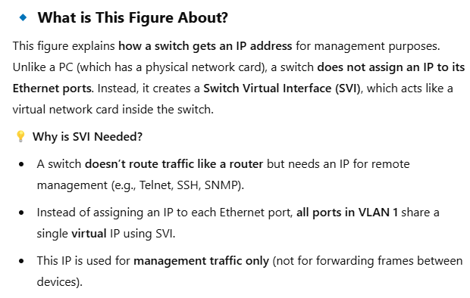
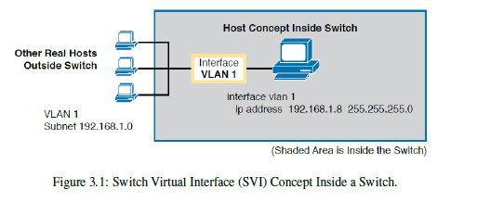
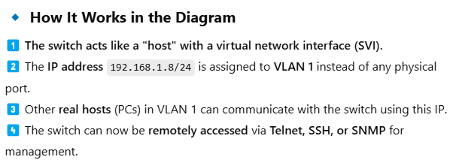
Switch Virtual Interface (SVI) Concept Inside a Switch 🚀

Slide 19
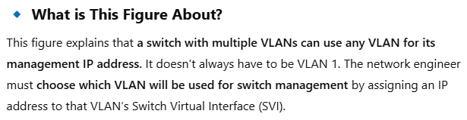
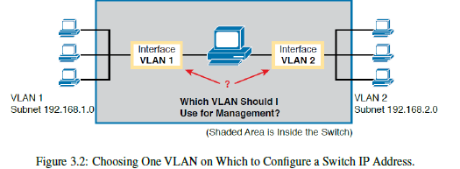
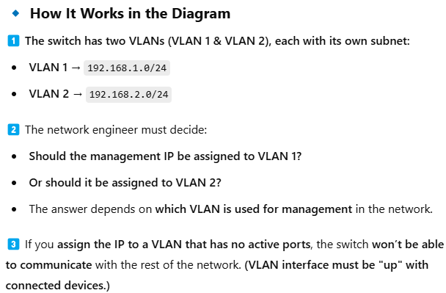
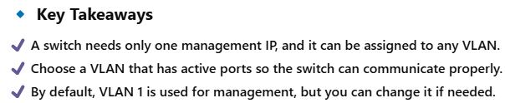
Choosing a VLAN for Switch Management 🚀

Slide 20
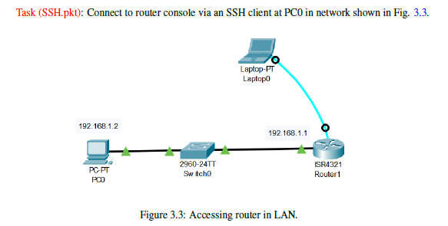

Slide 21
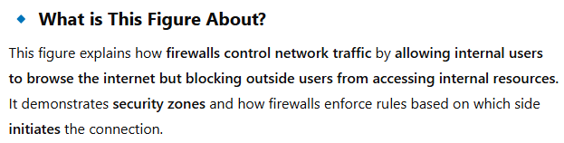
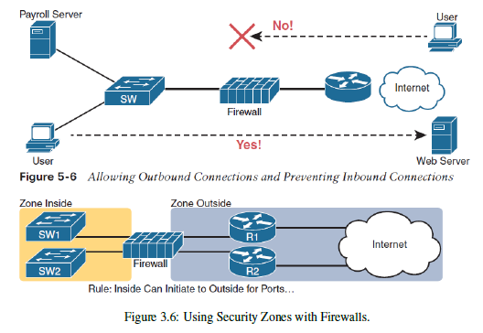
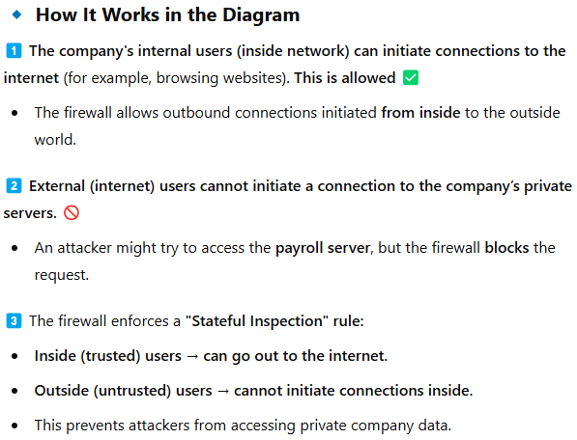
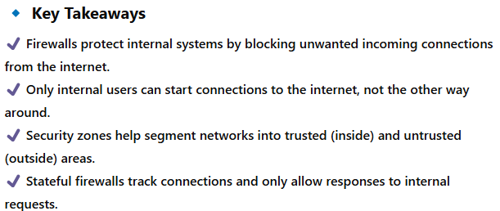
Using Security Zones with Firewalls 🔥🔒

Slide 22




Using a DMZ for Public Web Servers 🌐🔒

Slide 23




IPS and Signature Database 🔍🛡️

Slide 24




Next-Generation Firewall with Next-Generation IPS Module 🚀🔥

Slide 25


• Configure the nodes in INSIDE zone:
– PC01 to PC05: IP Configuration: DHCP enabled.
• Assign static IPs to PCs and server in INTERNET zone:
– PC1: 20.20.20.2/24
– PC2: 20.20.20.3/24
– Server0: PC1: 20.20.20.200/24 (running www)
• Assign static IPs to servers residing in DMZ zone:
– web-server: 200.1.220.242/28 (running www)
– dns-server: 200.1.220.243/28 (running dns) with "A record dmz-server = 200.1.220.243".
– email-server: 200.1.220.244/28
• Connect the ASA 5506-X firewall to three 2960-24TT switches. Click on the firewall and go to
CLI tab to be able to issue commands. Set the hostname to "FW" and set the date and time on the
firewall device:

